Slide 1

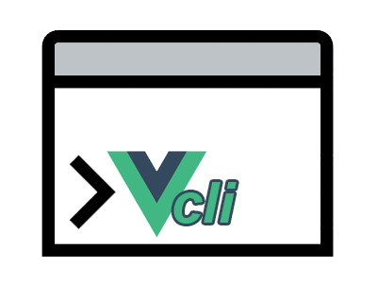
Vitejs vs Vue-CLI (Webpack)
Authors: Andrej Kocev (173148) & Filip Tanevski (173165)

Slide 2
Vite
Vite.js is a build tool and development environment that was created by Evan You, the same individual who created Vue.js. Vite, which is pronounced like "veet" (the French word for "fast"), was first released in 2020. It's designed to be a fast, lightweight, and highly efficient build tool for modern web development, especially when working with JavaScript frameworks like Vue.js or React. Vite is known for its speed and simplicity, making it an excellent choice for building web applications. Some key features include:
EcmaScript Modules | Dev server with HMR (Hot Module Replacement) | Native support for Vue | Plugin system | Efficient production builds

Slide 3
Vue-CLI
Vue CLI, short for Vue Command Line Interface, is a command-line tool that simplifies the process of setting up, configuring, and managing Vue.js projects. It was created by the Vue.js team and is an official tool for building Vue.js applications. Vue CLI provides a standardized and efficient way to create, develop, and build Vue.js projects, making it easier for developers to get started and maintain their applications. Some key features include:
Project generation | Interactive project setup | Plugin system | Development server | Vue UI

Slide 4
Objectives
We aim to present a clear picture of the strengths and weaknesses of these tools, making it easier for developers to choose the one that aligns best with their project requirements. We'll explore project setup, development experience, production build processes, and community support to help you decide between Vite and Vue CLI for your next project. We will take a look into a few aspects of using both these tools such as:
Project setup speed |  | Build speed & bundle size | Development server performance
Configuration and customization | Plugin ecosystem | Community and documentation

Slide 5
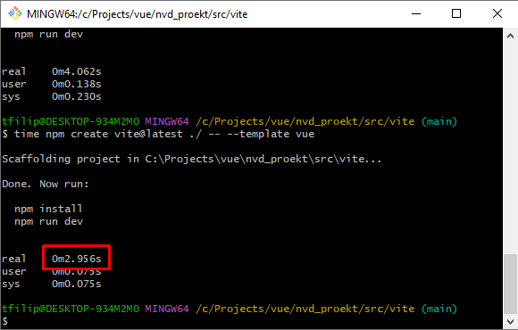
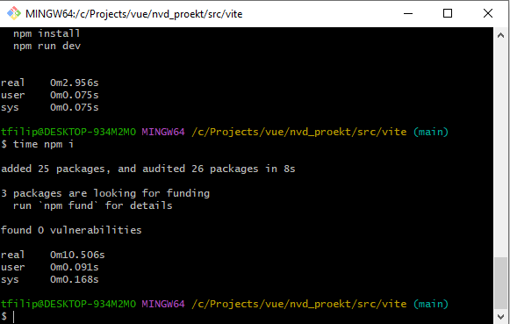
Project setup speed: Vite
As we can see from the screenshots, the project creation only took ~3 seconds, however this is without the npm install command. If we factor that in as well, we get around 13 seconds.

Slide 6
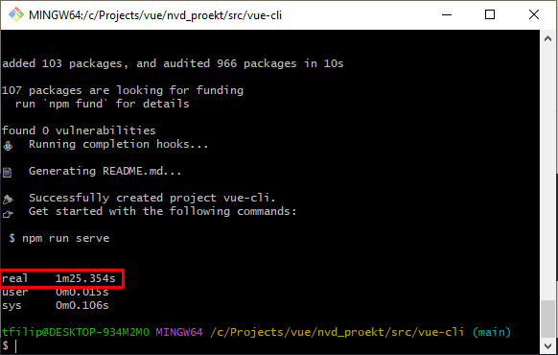
Project setup speed: Vue-CLI
The Vue-CLI not only scaffolds the project, it also runs a `npm install` so you don’t have to. Regardless of that, the whole process of creating the project took 1 minute and 25 seconds as we can see from the screenshot.

Slide 7
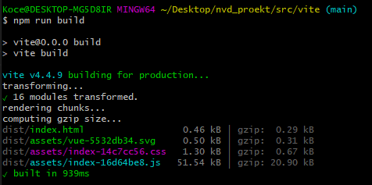
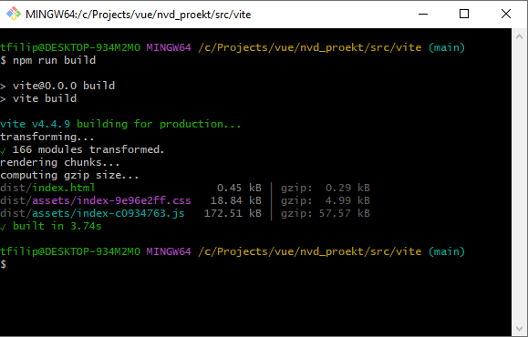
Build speed & bundle size: Vite
For this, we did a comparison on both scaffolded project in their initial states, and after some development.
The time it took to create a production-ready build with Vite for the initial scaffolded project was just around 1 second and the bundle size being around 53kb unzipped:
After some development, the production-ready bundle took about 3 seconds with the size being about 190kb unzipped:

Slide 8
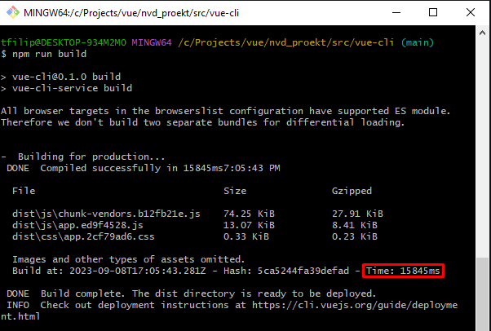
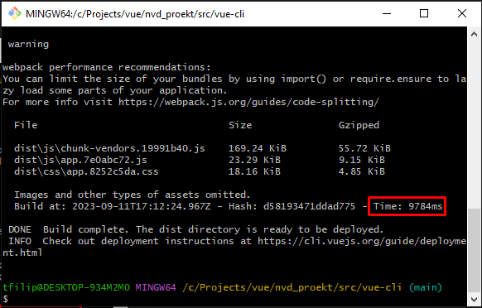
Build speed & bundle size: Vue-CLI
For this, we did a comparison on both scaffolded project in their initial states, and after some development.
The time it took to create a production-ready build with Vue-CLI for the initial scaffolded project was around 16 seconds with the bundle size being around 88KiB(kibibytes) or 90kbs
After some development the same process took around 10 seconds with the bundle size being 210KiB or 215kbs

Slide 9
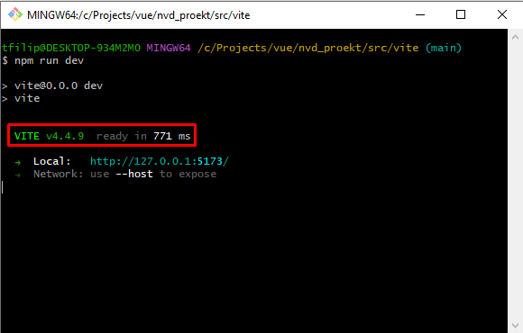
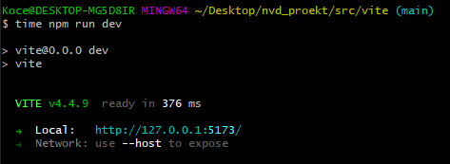
Development server performance: Vite
For this, we did a comparison on both scaffolded project in their initial states, and after some development.
The initial time that it took to start a development server in Vite was an impressive 376 ms:
After further development, we ran the local server again, and it was up and running in 771 ms.

Slide 10
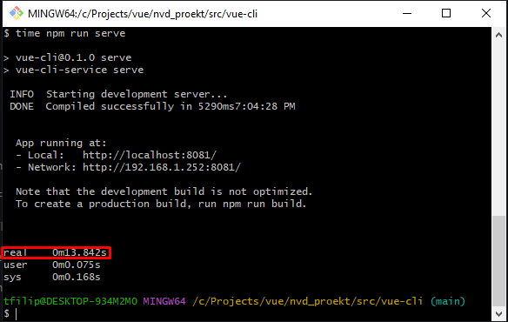
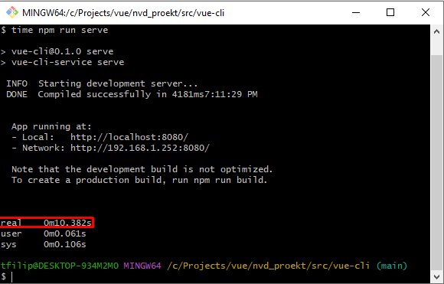
Development server performance: Vue-CLI
For this, we did a comparison on both scaffolded project in their initial states, and after some development.
After further development and removing some of the boilerplate that came with the project scaffolding we ran the local server again, and it was up and running in ~10 seconds.
The initial time that it took to start a development server with Vue-CLI was ~14 seconds.

Slide 11
Conclusion
The comparison between Vite and Vue CLI highlights their distinct strengths and characteristics. Vite excels in rapid development, offering a quick setup and modern development experience. Vue CLI, with its extensive plugin ecosystem and stable community, is a versatile choice for customization and reliability.
The choice between these tools depends on your project's needs. Vite is ideal for modern web development, while Vue CLI suits projects requiring customization and stability. Both tools empower developers to create exceptional web experiences in an ever-evolving field.
As you consider the right tool for your project, remember that staying informed about emerging technologies is essential. Your understanding of Vite and Vue CLI will enhance your ability to make informed decisions and create outstanding web applications.

